Slide 1
Presidential election campaign finances
Dan Edie, Megan Chang, & Nicholas Prentkowski

Slide 2
introduction
Initial questions
sources
How much are candidates spending on elections?
Are the most populous states contributing the most money?
Federal Election Commission's API
Pull data on campaign receipts
MIT's Election Lab database
Number of votes each candidate received

Slide 3
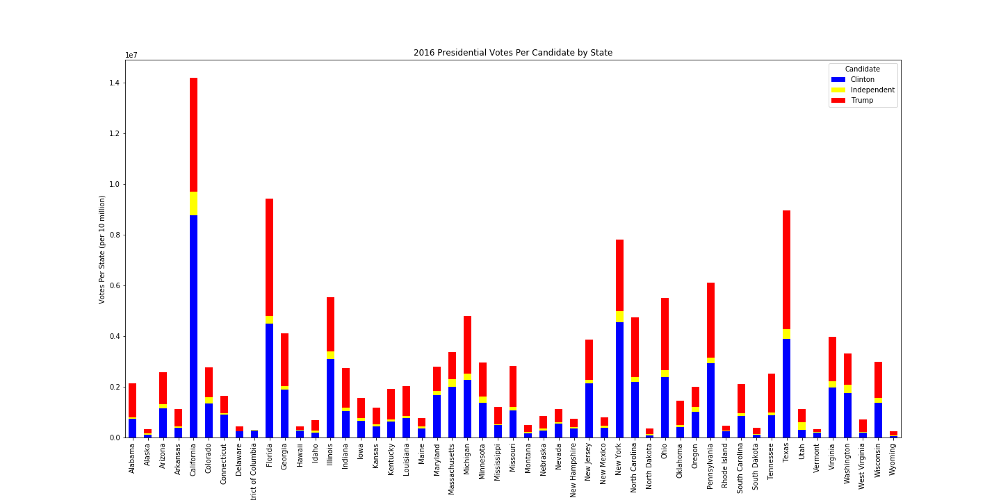

Slide 5
Money raised by democrats matches how long they actively campaigned
Republicans not so much: Kasich was last to drop before convention

Slide 6
Billionaires have blown the 2016 numbers out of the water
Bloomberg has more money than both parties in 2016
Shows amount of money doesn’t always mean nomination

Slide 7
Democrats spent more money in 2016
Currently, thanks to Bloomberg, democrats are vastly outspending republicans
However, right now, not much campaigning is happening

